Slide 1

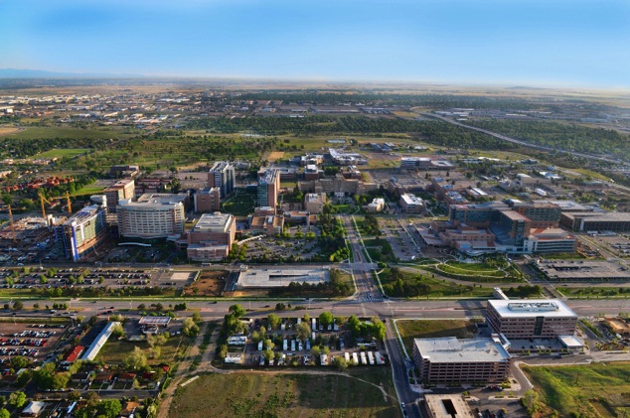
Mechanisms of ALK Resistance & Implications for Treatment
Acquired Resistance Patient Forum
In ALK, ROS1 & EGFR Lung Cancers
September 6, 2014 | Boston
Robert C. Doebele, MD, PhD
Associate Professor,
Thoracic Malignancies Program,
University of Colorado Cancer Center

Slide 2

Disclosures
Pfizer: Research grant, consulting, advisory board
Boehringer Ingelheim: Consulting, advisory board
Eli Lilly/ImClone: Research grant, travel support
Mirati Therapeutics: Research Grant
OxOnc: Consulting
Loxo Oncology: Consulting
Abbott Molecular: licensed patent

Slide 3
Rapid success in a short time: ALK drug development timeline
EML4-ALK discovered in NSCLC
Crizotinib resistance mechanism reported
Crizotinib US FDA approved for ALK+ NSCLC
NPM-ALK discovered in ALCL
Ceritinib US FDA approved for
ALK+, crizotinib-resistant NSCLC
1994
2007
2010
2011
2014

Slide 4
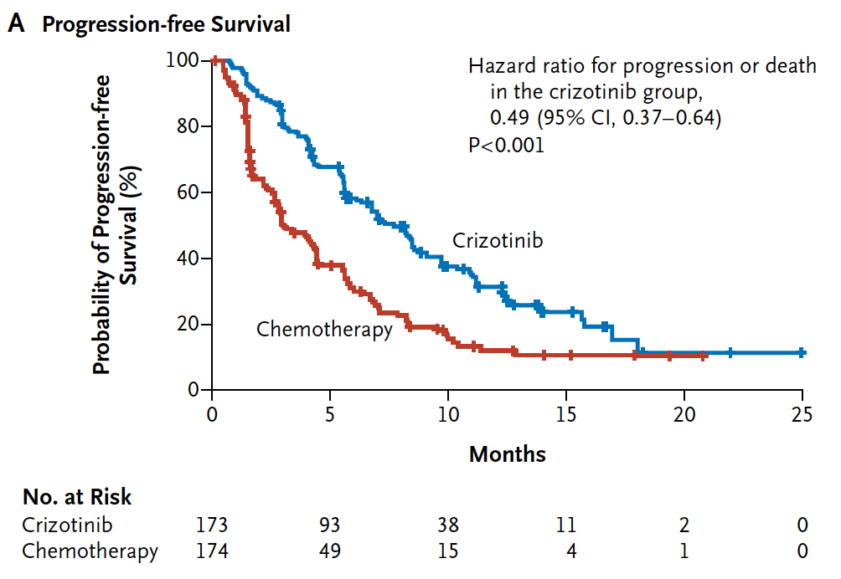
Crizotinib superior to standard chemotherapy:
1st Line therapy
2nd Line therapy
Pfizer 1014: Crizotinib vs. Platinum/Pemetrexed
Pfizer 1007: Crizotinib vs. Chemotherapy
ORR: Crizotinib 74% vs. Chemo 45%
ORR: Crizotinib 65% vs. Chemo 20%
But this does not mean we should never use chemotherapy (more on this later)
Mok et al. ASCO 2014, abstr 8002
Shaw et al., NEJM 2013

Slide 5
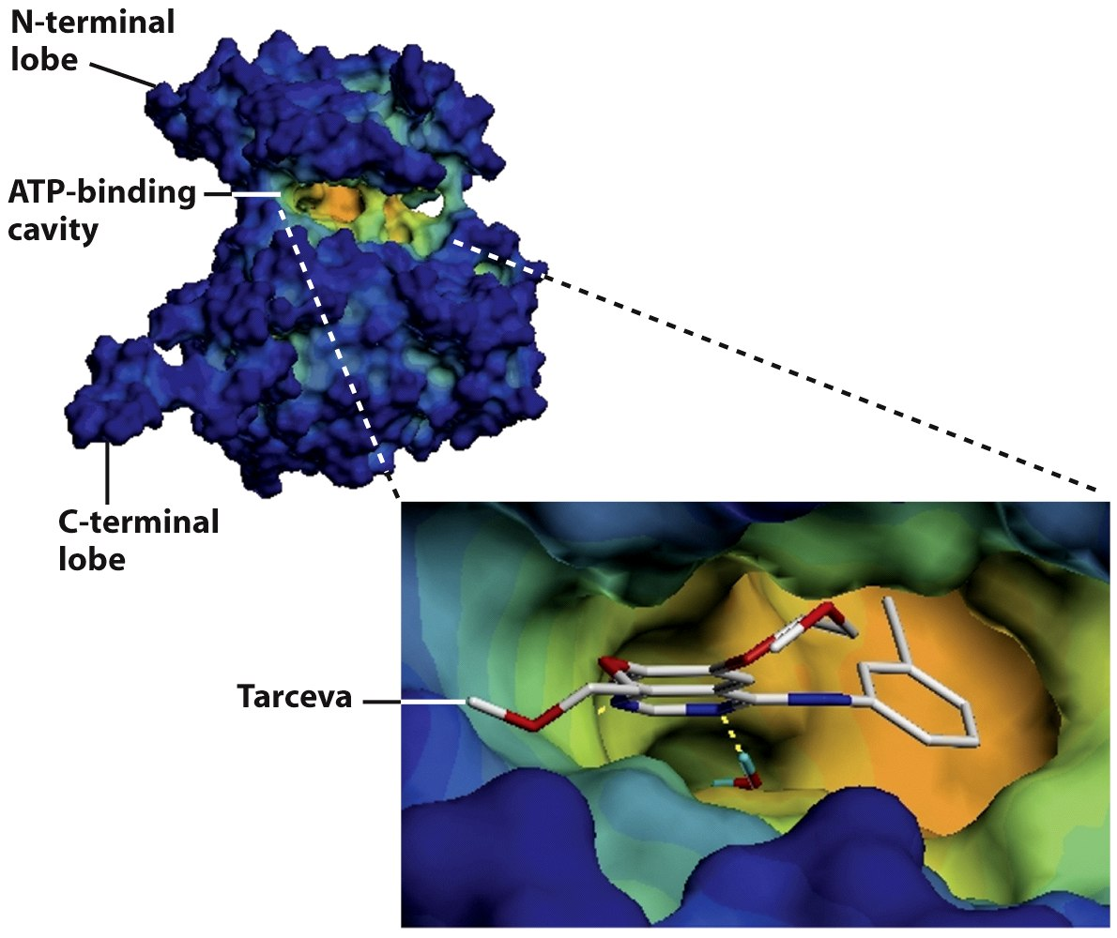



Kinase domain mutations: Lock and Key
ALK
crizotinib

Slide 6




Master Keys to open the new lock?
ceritinib
alectinib
AP26113
PF-3922

Slide 7
How do you choose the right key?
Access to a clinical trial?
FDA-approved?
Ceritinib
Efficacy?
Does it work (well)?
For how long?
Brain metastases?
Tolerability?

Slide 8
Excellent tumor response seen with multiple next generation ALK inhibitors
ceritinib
alectinib
AP26113
56%
55%
61%

Slide 9

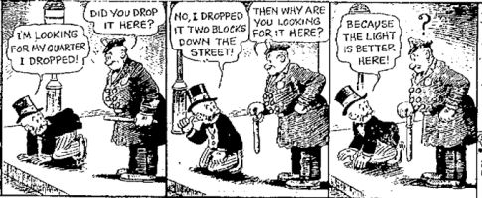
Why the focus on mutations? Looking under the lamp post
Important mechanism of drug resistance
Easy to detect
Easy to drug

Slide 10



Bypass Signaling: Moving next door
ALK
IGF-1R
EGFR

Slide 11
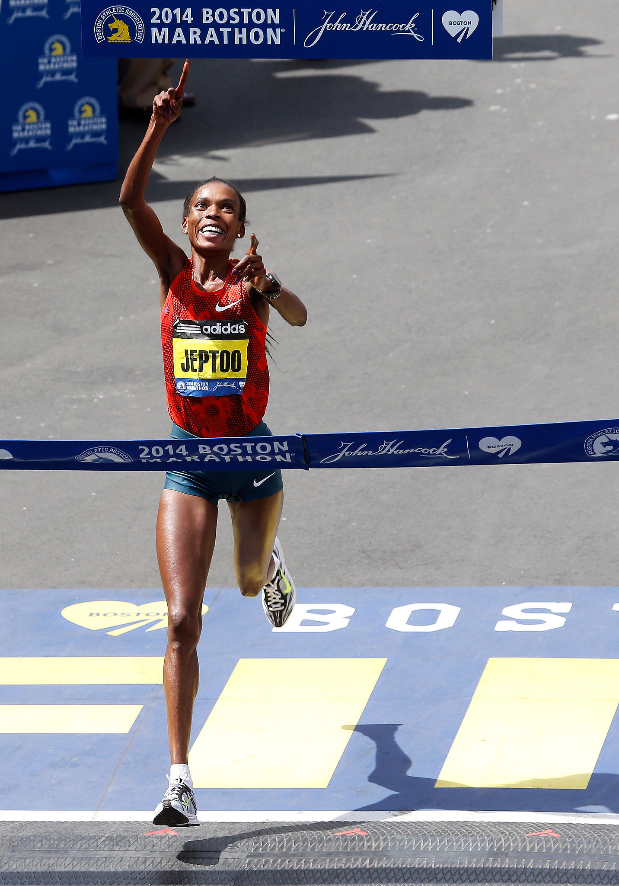

Which drugs to use when? Sprint vs. Marathon
crizotinib = 7.7 months*
crizotinib = 7.7 months*
ceritinib = 6.9 months
ceritinib = 9.5 months
Sequential therapy ≈ 14.6 months
Shaw et al., NEJM 2013, varies with study and line of therapy*
Shaw et al., NEJM 2014

Slide 12

crizotinib
ceritinib

Slide 13
Measuring drugs head to head: ALEX Study
Eligible patients:
Advanced or metastatic ALK+ NSCLC
Treatment naïve
ECOG PS 0–2
N≈286
Alectinib 600mg BID
^{(n≈143)}
Until PD*, toxicity, withdrawal or death
Subsequent therapy and survival follow up
R 1:1
Crizotinib 250mg BID
^{(n≈143)}
Ceritinib
or
Alectinib
*RECIST v1.1
Notes:
those with isolated asymptomatic CNS progression will be permitted to continue treatment beyond that progression until either systemic PD or symptomatic CNS progression is confirmed by the investigator
time to CNS progression will be retrospectively assessed by the IRC using two separate criteria: RECIST and RANO.

Slide 14

Local ablative therapy (LAT) SABR - stereotactic ablative radiotherapy
All Patients
Brain
Other Organs
delaying switch to another therapy
Weickhardt et al. J Thorac Oncol 2012
Gan et al., Int J Radiat Oncol Biol Phys. 2014

Slide 15
Criteria for local ablative therapy (LAT)
1. ALK+ (or EGFR mutant) metastatic NSCLC
2. Relevant TKI (e.g., crizotinib or ceritinib) is well
tolerated
3. Oligoprogressive disease on TKI therapy, defined as:
CNS (brain) progression without leptomeningeal disease amenable to WBRT, SRS or surgical resection
Progression in < 4 extra-CNS (e.g., lung, liver, bone, or LN) sites amenable to SABR or surgical resection
Weickhardt et al. J Thorac Oncol 2012
Gan et al., Int J Radiat Oncol Biol Phys. 2014

Slide 16

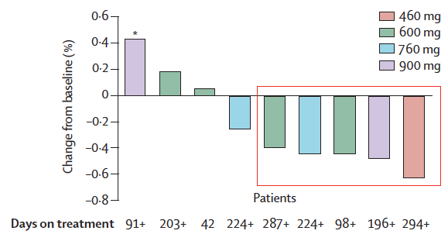
Brain: a sanctuary for metastases
Brain metastases
Alectinib CNS Response = 51% (N = 21)
Blood-
Brain
Barrier
crizotinib
Gadgeel et al., Lancet Oncol 2014

Slide 17

Prioritizing existing drugs: Pemetrexed
Camidge et al., J Thoracic Oncol. (2011)
Doebele lab, unpublished results

Slide 18


Comparison of pemetrexed in ALK+ vs. unselected lung adenocarcinoma patients
Trial | Tumor response | PFS (months)
PROFILE 1007 (ALK+, pemetrexed) | 29.3% | 4.2
Hanna et al. (adeno, pemetrexed) | 12.8% | 3.5
PROFILE 1014 (ALK+, cis/pem) | 45% | 7.0
Scagliotti et al. (adeno, cis/pem) | 28.9% | 5.5
Pemetrexed
Trial | Tumor response | PFS (months)
PROFILE 1007 (ALK+, docetaxel) | 6.9% | 2.7
Hanna et al. (adeno, docetaxel) | 9.9% | 3.5
Docetaxel
Shaw et al., NEJM 2013
Scagliotti et al., Oncologist 2009
Mok et al., ASCO 2014

Slide 19
SWOG 1300: coming to a site near you
Eligibility
Non-SCC NSCLC patients with ALK+ tumors (FISH)
Systemic progression on crizotinib after clinical benefit (either ORR or SD ≥ 3 mo.)
Start treatment within 3-30d post-criz
Absent/asymptomatic brain metastases
pemetrexed-naïve
pemetrexed
500 mg/m² IV d1
re-challenge
crizotinib
250 PO BID
Disease
Progression
R A N D O M I Z E
N = 108
1:1
crizotinib 250 mg
PO BID daily
+
pemetrexed
500 mg/m² IV d1
BIOPSY
Resistance mechanisms and association with benefit
Trial PI: Camidge
Translational Medicine PI: Doebele

Slide 20
ALK+ Treatment Algorithm*
Crizotinib
Oligoprogression?
Study available?
No
Y
Y
N
Yes
Alectinib
or
AP26113
S1300
ceritinib
LAT
Y
Oligoprogression?
Continue current therapy
N
Study available?
Y
Y
N
HSP90
Immunotherapy
Chemo
*Subject to change (rapidly)

Slide 21
Summary
Crizotinib the standard of care for ALK+ patients at diagnosis
Local ablative therapy an option for patients with oligoprogression
Drug resistance overcome by 2nd generation ALK inhibitors
Hope for better and longer drug inhibition of brain metastases
Chemotherapy still an option for ALK+ patients

Slide 22
Acknowledgements
University of Colorado Thoracic Oncology
Dara Aisner, MD, PhD
Eamon Berge, MD
Paul A. Bunn, Jr., MD
D. Ross Camidge,MD, PhD
Laurie Gaspar, MD
Wilbur A. Franklin, MD
Fred Hirsch, MD, PhD
Brian Kavanagh, MD
Kimi Kondo, MD
Derek Linderman, MD
Daniel Merrick, MD
Robert Meguid, MD, MPH
Ana Oton, MD
Tom Purcell, MD, MBA
John Mitchell, MD
Peter Sachs, MD
Marileila Varella-Garcia, PhD
Michael Weyant, MD
Patients and their Families
Funding
V Foundation for Cancer Research
Boettcher Webb-Waring
K12 (NIH/NCI 5K12CA086913)
CU Lung SPORE (P50 CA058187)
CCTSI (UL1 RR025780)
CCSG (P30 CA046934
Colorado BDEG
Bonnie J. Addario Lung Cancer Foundation
Doebele Lab
Anh T. Le, BA
Aria Vaishnavi, BS
Eamon Berge, MD
Kurtis D. Davies, PhD
Amanda Pilling, PhD

